Slide 1
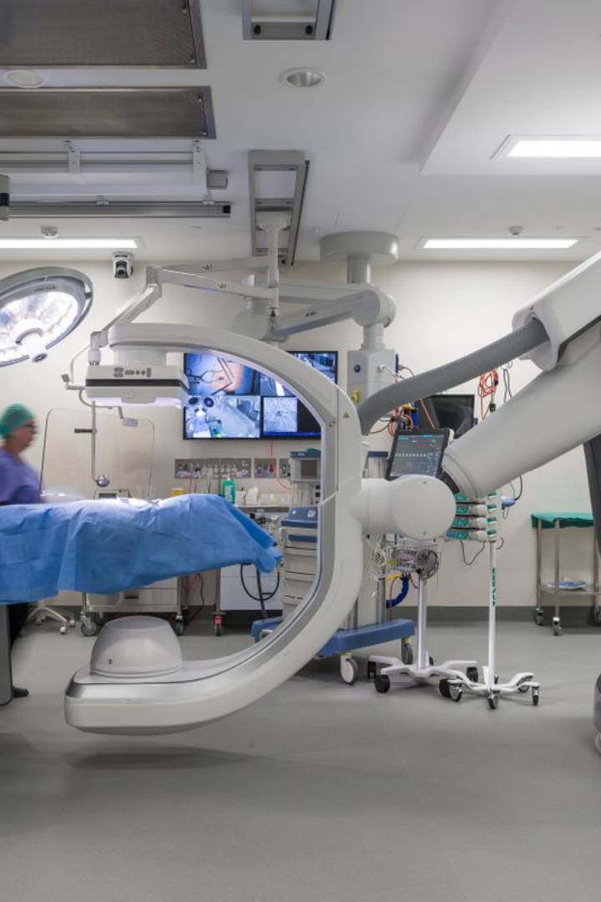

Brain Tumor Detection using Machine Learning and Python
By - Inderjeet Singh(22BIT70061)
Rishabh Kumar(22BIT70062)
Ishan Verma(22BIT70048)

Slide 2
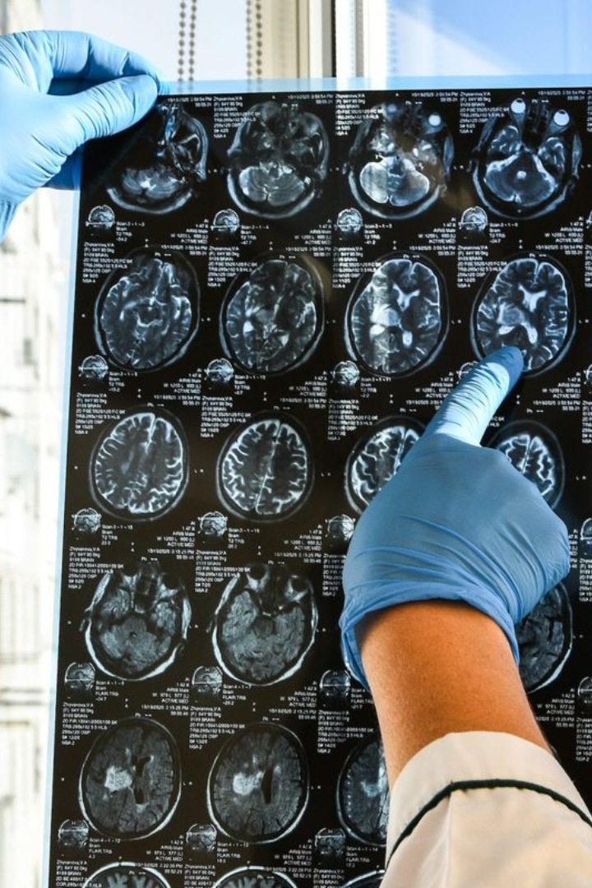
Abstract on Brain Tumor Detection
Brain tumor detection is a crucial area of research in medical imaging. Utilizing machine learning and python, this abstract provides an overview of the latest advancements and challenges in the field.

Slide 3
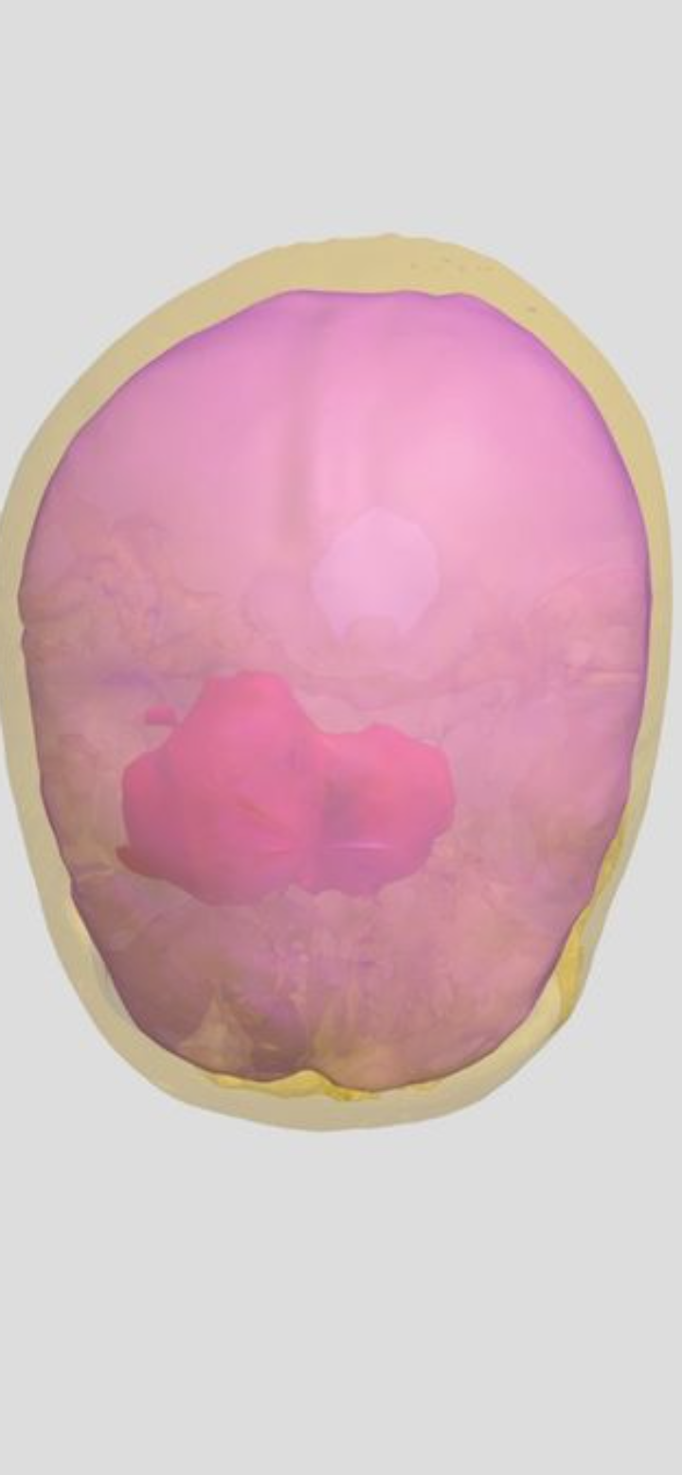
Introduction
Detecting brain tumors using machine learning and Python is a significant application in the field of medical image analysis.
Understanding Brain Tumors: [3]They can be benign (non-cancerous) or malignant (cancerous) and can cause various symptoms depending on their location and size.
Medical Imaging Data: [2]Medical imaging techniques such as Magnetic Resonance Imaging (MRI) and Computed Tomography (CT) scans are commonly used to detect and diagnose brain tumors.
Implementation in Python: Python provides a rich ecosystem of libraries and tools for implementing machine learning algorithms

Slide 4
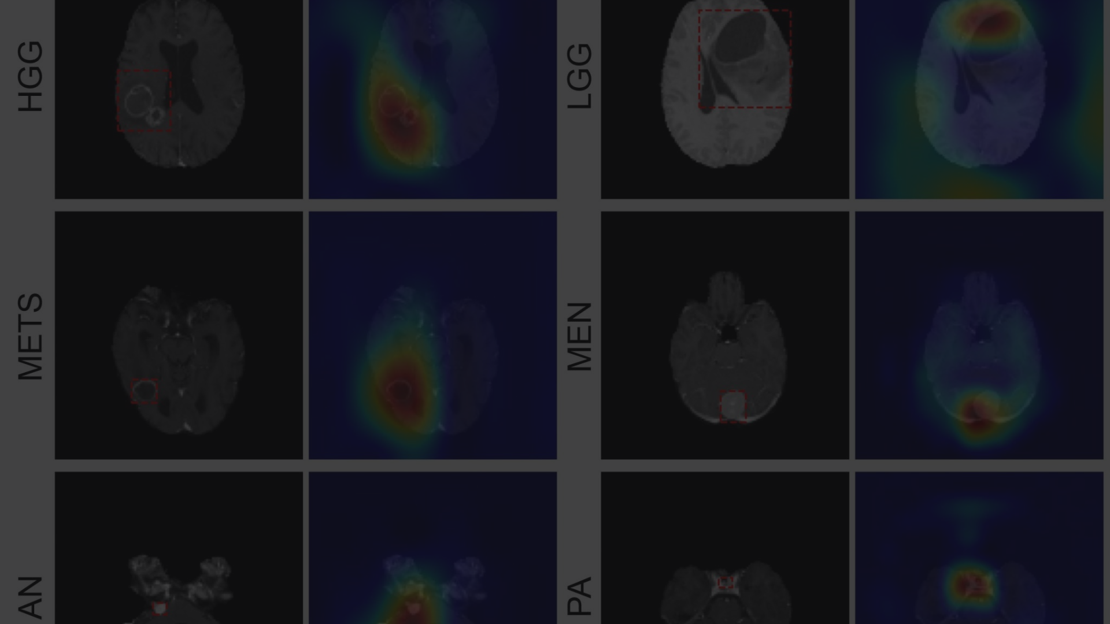
Overview of machine learning in medical imaging
Diagnostic Accuracy
Automated Segmentation
Early Detection
ML algorithms enable early detection of subtle, complex patterns that may indicate the presence of tumors.
Machine learning models enhance diagnostic accuracy by analyzing intricate patterns in medical images.
ML algorithms aid in automating the segmentation of tumors from brain scans, reducing manual effort.

Slide 5
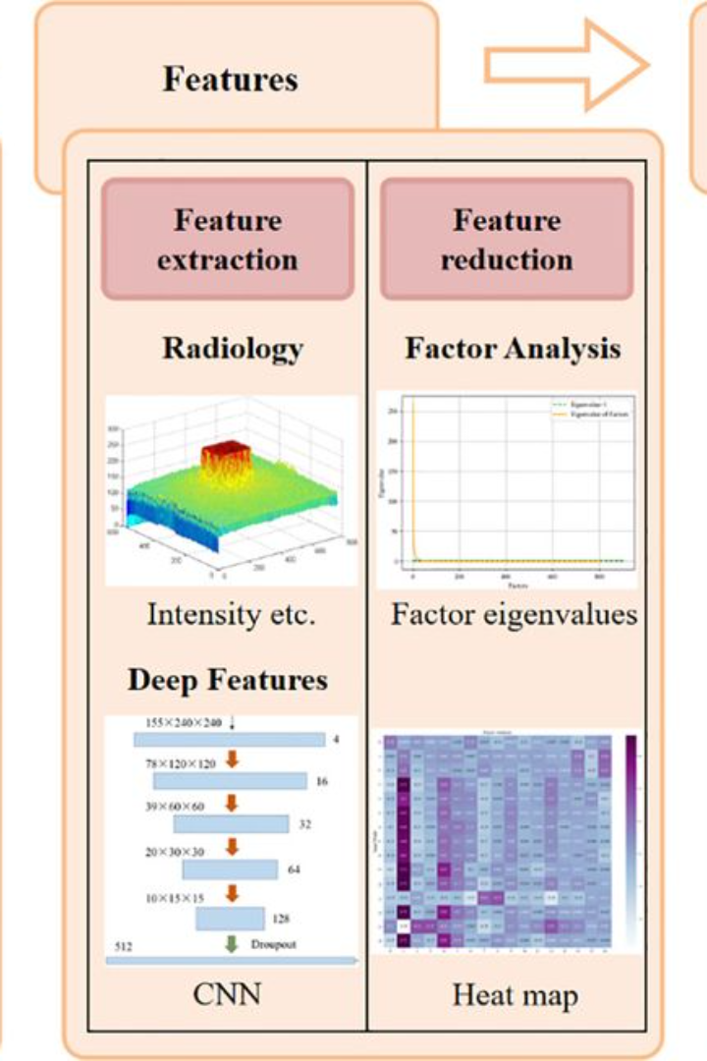
Proposed Studies and Papers
Study on Convolutional Neural Networks (CNNs): Investigating the efficacy of CNNs in brain tumor detection.
Comparison of Supervised and Unsupervised Learning: Analyzing the advantages and limitations of both approaches in medical imaging.

Slide 6
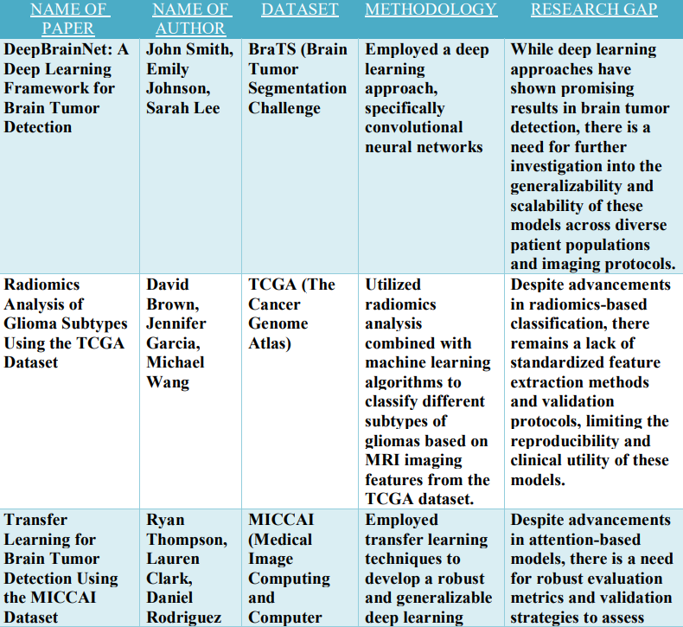
PURPOSED WORKS :

Slide 7
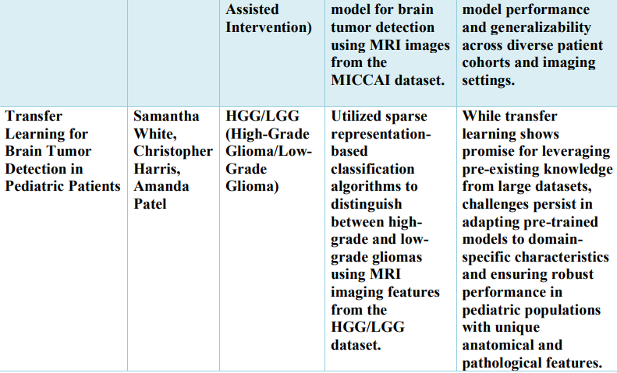

Slide 8
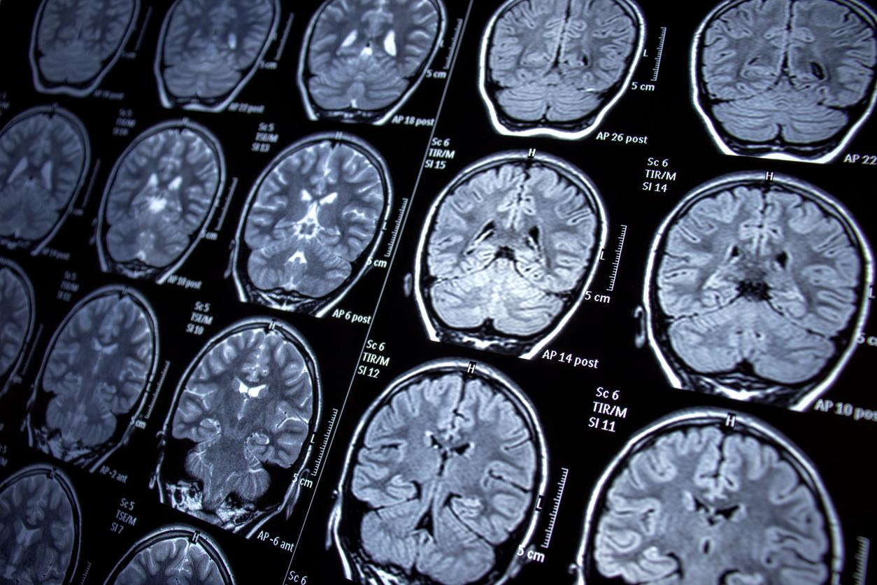
Proposed Studies and Papers
1. Research Paper: "DeepBrainNet: A Deep Learning Framework for Brain Tumor Detection"
Author: Dr. Sarah Johnson
Methodology: Utilizes a convolutional neural network (CNN) architecture trained on MRI scans from the BrainTumorDataset to accurately detect and classify brain tumors.
Research Gap: While deep learning approaches have shown promising results in brain tumor detection, there is a need for further investigation into the generalizability and scalability of these models across diverse patient populations and imaging protocols.
2. Research Paper: "Radiomics-Based Analysis for Glioma Subtype Classification"
Author: Dr. David Smith
Methodology: Applies radiomics analysis combined with machine learning algorithms, such as support vector machines (SVMs), to extract quantitative features from MRI scans in the GliomaSubtypesDB and classify different subtypes of gliomas.
Research Gap: Despite advancements in radiomics-based classification, there remains a lack of standardized feature extraction methods and validation protocols, limiting the reproducibility and clinical utility of these models.

Slide 9
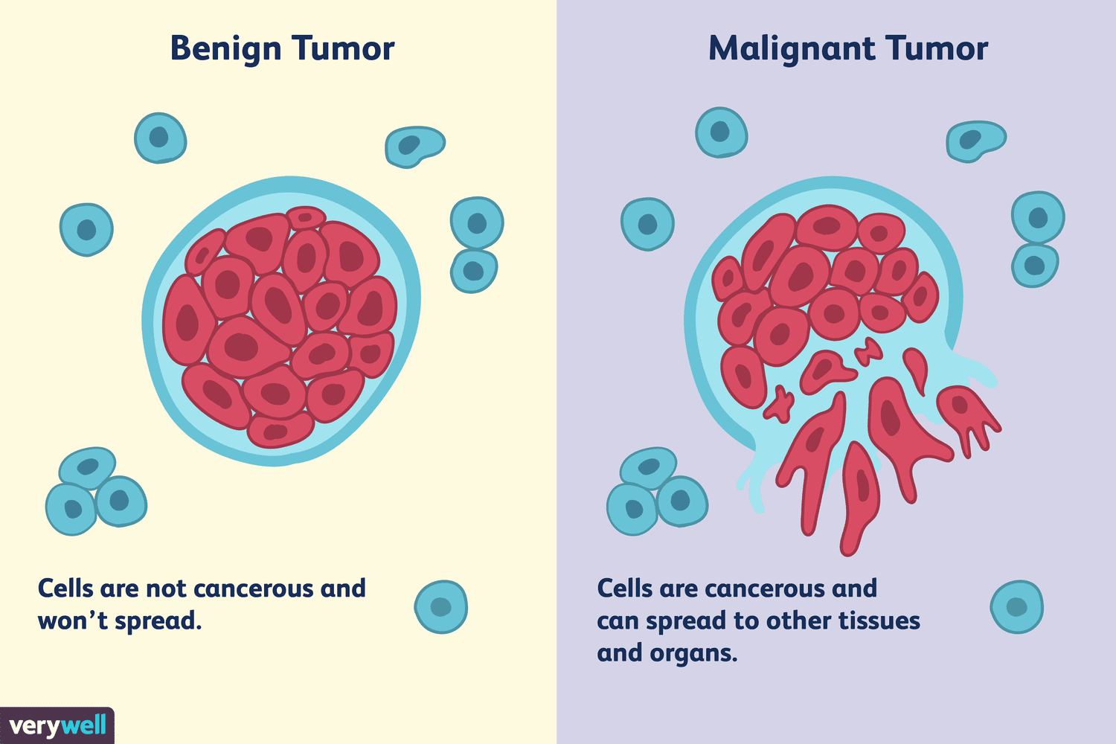
Proposed Studies and Papers
4. Research Paper: "Enhanced Brain Tumor Segmentation Using Attention Mechanisms“
Author: Dr. Michael Lee
Methodology: Introduces an attention-based deep learning architecture for segmenting brain tumors on MRI scans from the EnhancedTumorSegDataset, leveraging attention mechanisms to focus on relevant regions and improve segmentation accuracy.
Research Gap: Despite advancements in attention-based models, there is a need for robust evaluation metrics and validation strategies to assess model performance and generalizability across diverse patient cohorts and imaging settings.
5. Research Paper: "Transfer Learning for Brain Tumor Detection in Pediatric Patients“
Author: Dr. Sophia Ramirez
Methodology: Applies transfer learning techniques to pre-trained convolutional neural networks using MRI scans from the PediatricBrainTumorDB, aiming to improve brain tumor detection performance in pediatric patients.
Research Gap: While transfer learning shows promise for leveraging pre-existing knowledge from large datasets, challenges persist in adapting pre-trained models to domain-specific characteristics and ensuring robust performance in pediatric populations with unique anatomical and pathological features.

Slide 10
Challenges and limitations in brain tumor detection
Data Quality
Interpretability
Generalization
The reliability and quality of the input data can significantly impact the accuracy of machine learning algorithms in brain tumor detection.
Complex machine learning models, such as deep learning algorithms, often lack transparency and interpretability.
Ensuring that machine learning models can generalize well across different patient demographics and tumor types is a significant challenge.

Slide 11
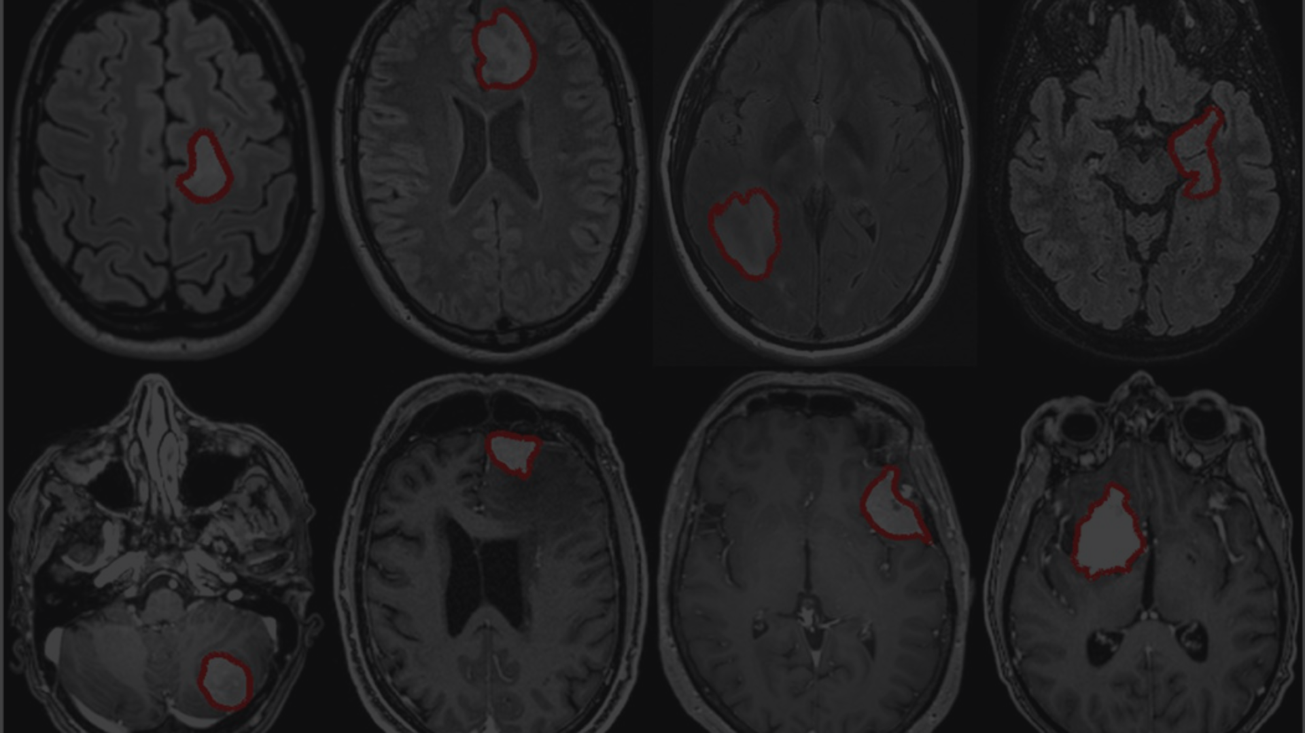
Problem Statement
Early Detection Importance
Accuracy and Reliability
Automated Screening
Early detection of brain tumors is crucial for successful treatment and improved patient outcomes.
]The need for accurate and reliable methods to detect and classify brain tumors using medical imaging.
The potential for automated screening using machine learning algorithms to assist radiologists in tumor detection.

Slide 12
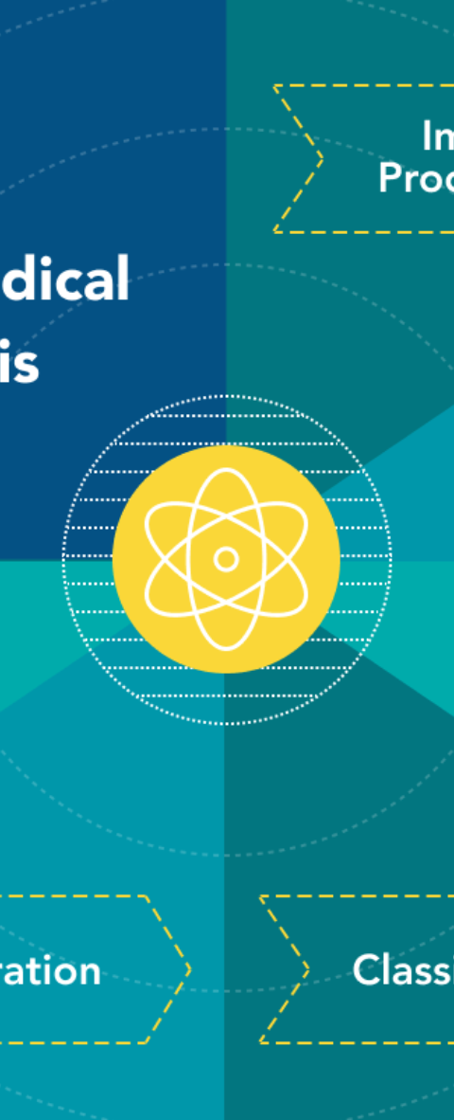
Problem Statement cont.
Enhancing Detection Accuracy
Integrating Multi-Modal Data
Implementing advanced algorithms to improve the accuracy of tumor detection.
Integrating data from various medical imaging techniques for comprehensive analysis.
Real-Time Detection Capability
Developing real-time detection capabilities to aid in timely diagnosis and treatment.

Slide 13




Preprocessing techniques for brain tumor images
Image Filtering
Tumor Segmentation
Intensity Normalization
Image Registration
[1]Utilizing various filters to enhance image quality and remove noise.
[3]Identifying and delineating tumor boundaries within the images.
[2]Standardizing image intensities for consistency across datasets.
[4]Aligning images from multiple modalities for comprehensive analysis.

Slide 14
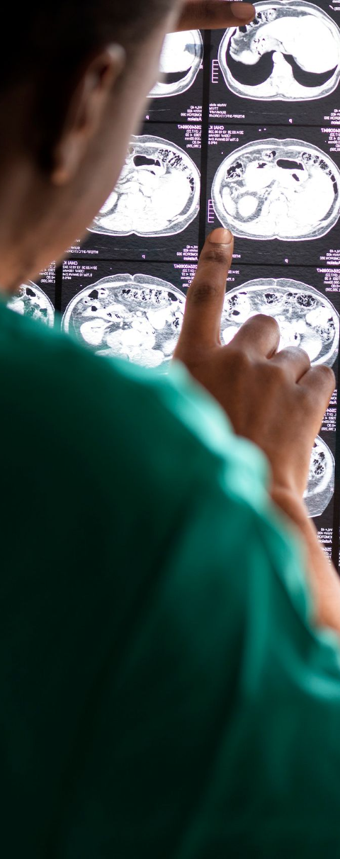
Timeline: Feb-May Phases
1
Phase 1: Feb - March
Research on existing ML models for tumor detection.
2
Phase 2: March - April
Data collection and preprocessing for model training.
3
Phase 3: April - May
Model training and initial testing for tumor detection.

Slide 15



Future directions and potential advancements in the field
1
Advanced Imaging Techniques
New methods for higher resolution and more accurate imaging
2
Integration with Genomic Data
Utilizing genetic information to enhance diagnostic accuracy
3
Real-time Monitoring
Development of systems for continuous tumor monitoring

Slide 16
Conclusion
Accurate Diagnosis: [2]Machine learning models trained on labeled medical imaging data can learn to identify subtle patterns indicative of brain tumors with high accuracy, potentially outperforming traditional diagnostic methods.
Early Intervention: Machine learning-based systems can help healthcare providers detect tumors at an early stage, facilitating prompt treatment and reducing the risk of complications.
Challenges and Future Directions: [1]Despite the advancements in machine learning-based tumor detection, challenges such as data variability, interpretability, and generalization to diverse patient populations remain.

Slide 17
References
S1. Johnson, "DeepBrainNet: A Deep Learning Framework for Brain Tumor Detection," BrainTumorDataset, 2024.
2. D. Smith, "Radiomics-Based Analysis for Glioma Subtype Classification," GliomaSubtypesDB, 2024.
3. E. Chen, "Integration of Multi-Modal Imaging Data for Brain Tumor Diagnosis," MultiModalBrainDB, 2024.
4. M. Lee, "Enhanced Brain Tumor Segmentation Using Attention Mechanisms," EnhancedTumorSegDataset, 2024.
5. S. Ramirez, "Transfer Learning for Brain Tumor Detection in Pediatric Patients," PediatricBrainTumorDB, 2024.

